Slide 1
Stargaze App Usability Study
December 20th, 2021
Team
Brian Thompson

Slide 2
Table of Contents
Section 1 Study Details
Section 2 Themes
Section 3 Insights & Recommendations

Slide 3
Study Details

Slide 4
Project Background
We’re creating a new app to help people purchase movie tickets hassle free.
Before launching we need to figure out if getting tickets through our app is easy for users to do.
We’d like to understand what specific challenges our users might face in the ordering, process and how we can help them fix those challenges.

Slide 5
Study Details
Research Questions
Participants
Methodology
How long does it take a user to select a movie and book tickets and or food and drinks from start to finish?
What can we learn from the steps users take to book their tickets?
Are there any parts where users get stuck?
Does the app provide a convenient or frustrating experience for the user?
How many times does a user use the app to get their movie tickets vs in person?
# participants: 5
Two males, Two females and one nonbinary individual between ages 16-50
Full-time or part-time workers, students, and parents
# of minutes: 60
Location: United States, Remote
Format: Unmoderated Usability Study
Users were asked to navigate through the stargaze app and order movie tickets on a low-fidelity prototype

Slide 6
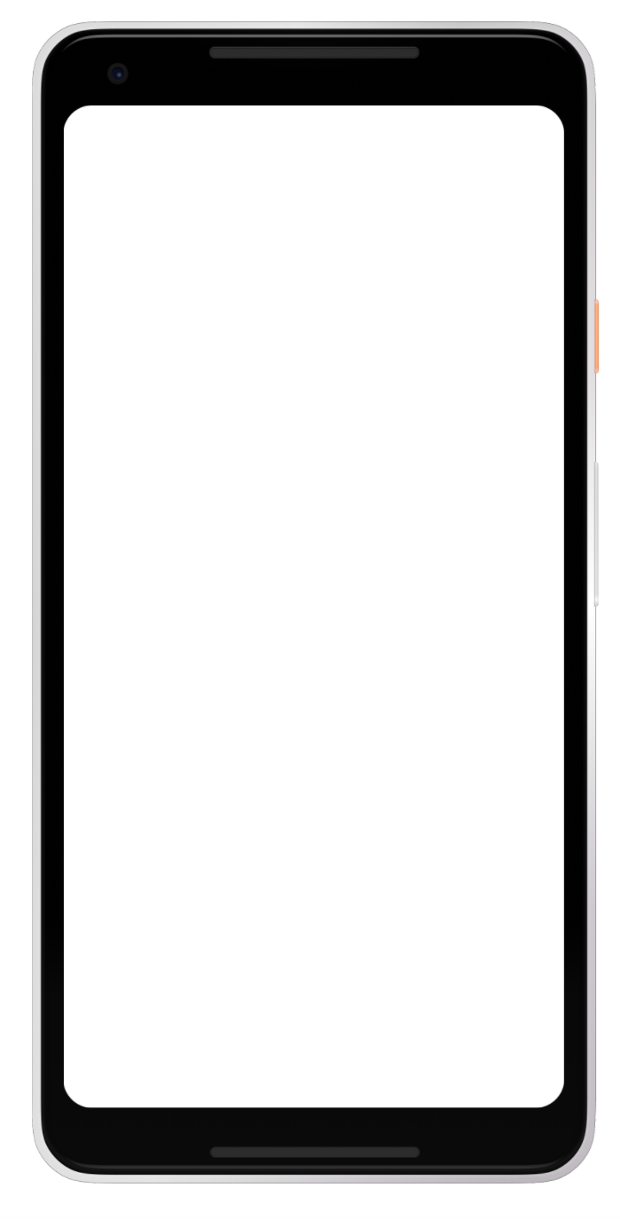
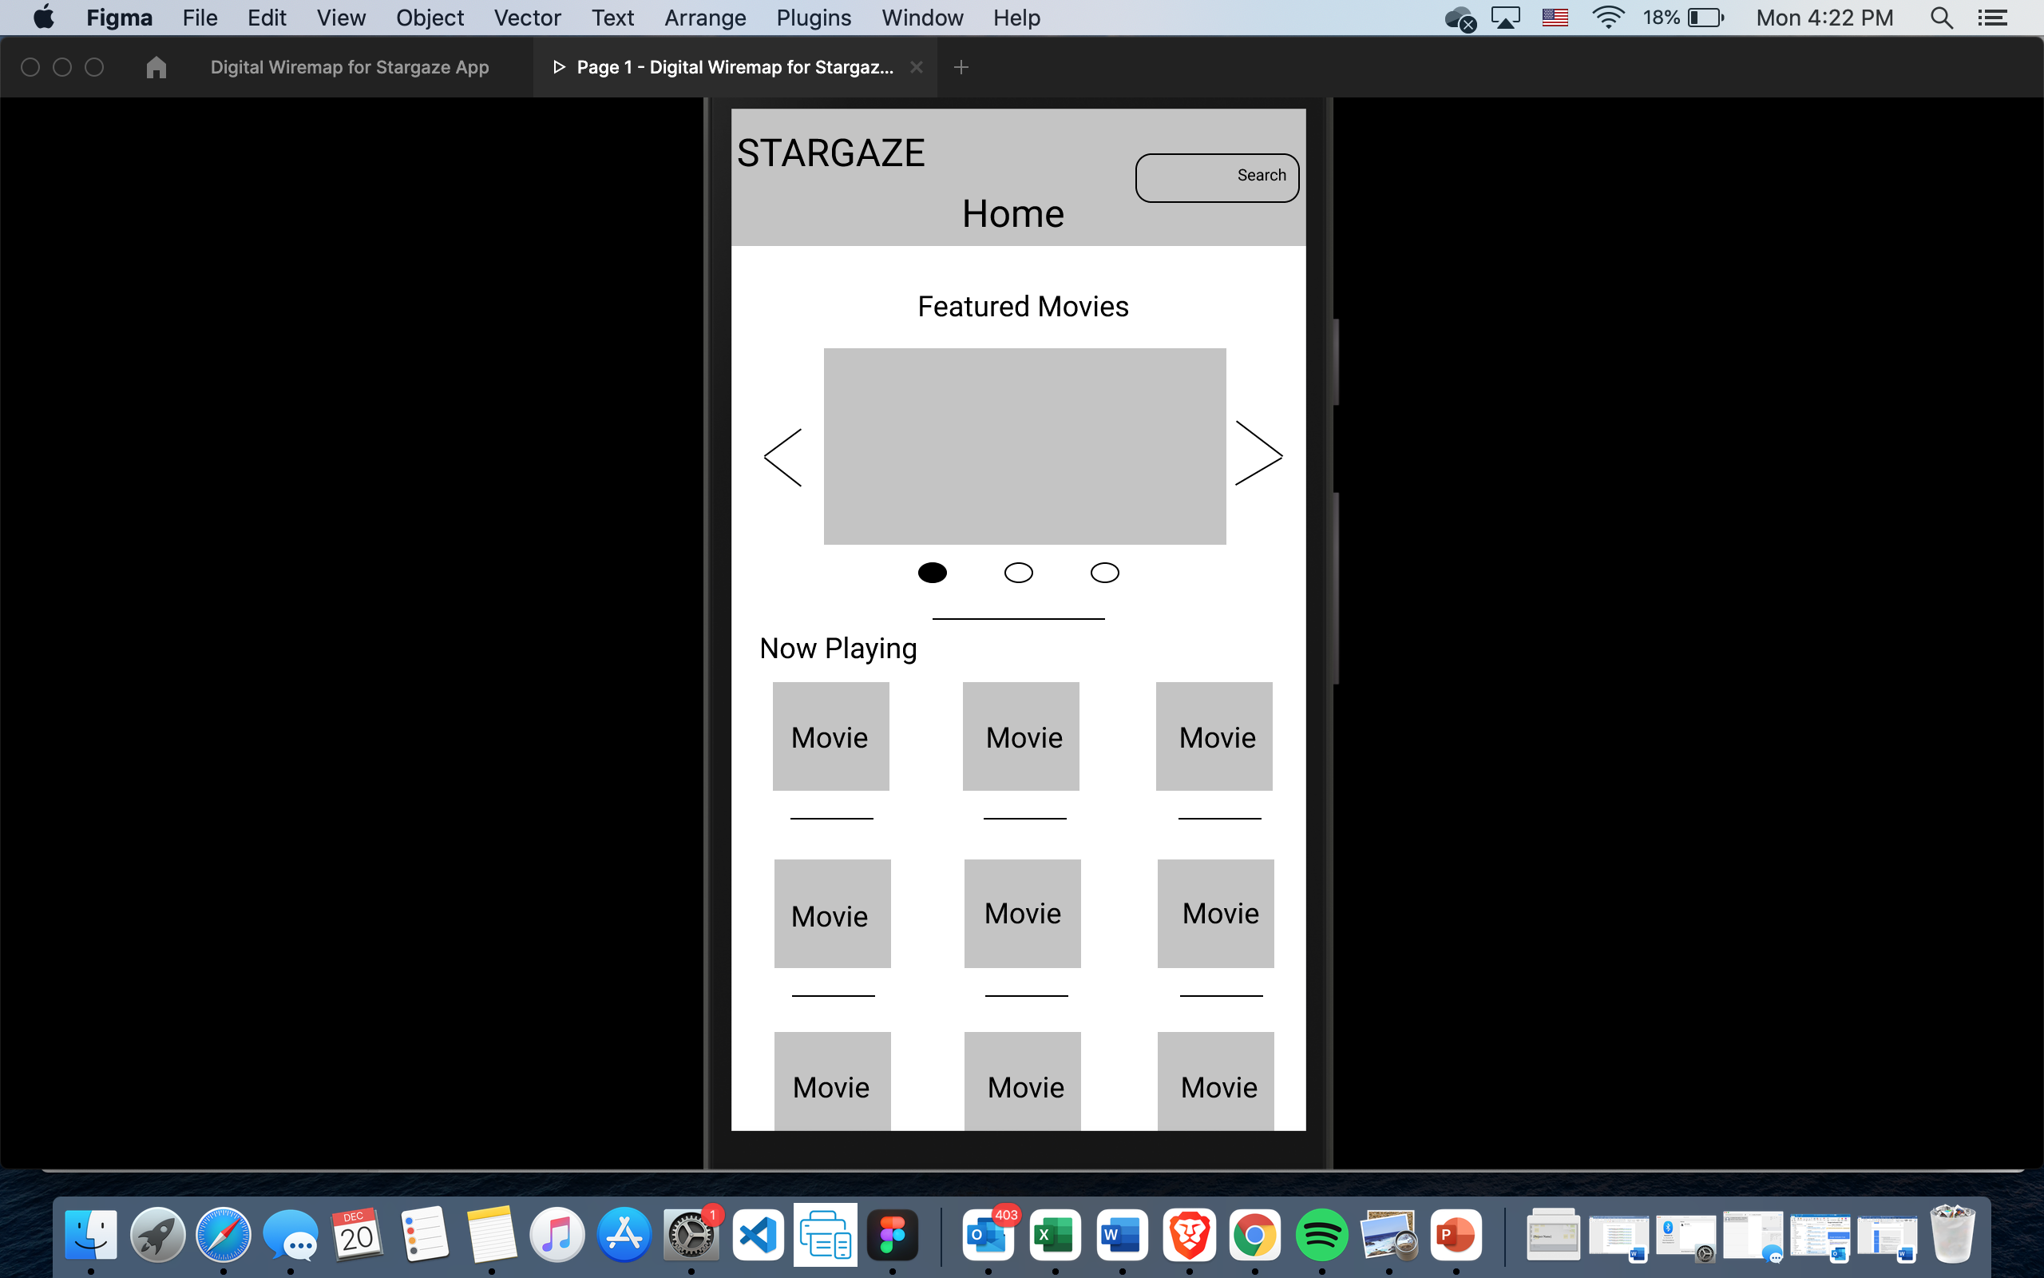

Prototype / Design Tested
The low fidelity app for Stargaze was tested and can be tested here

Slide 7
Themes

Slide 8
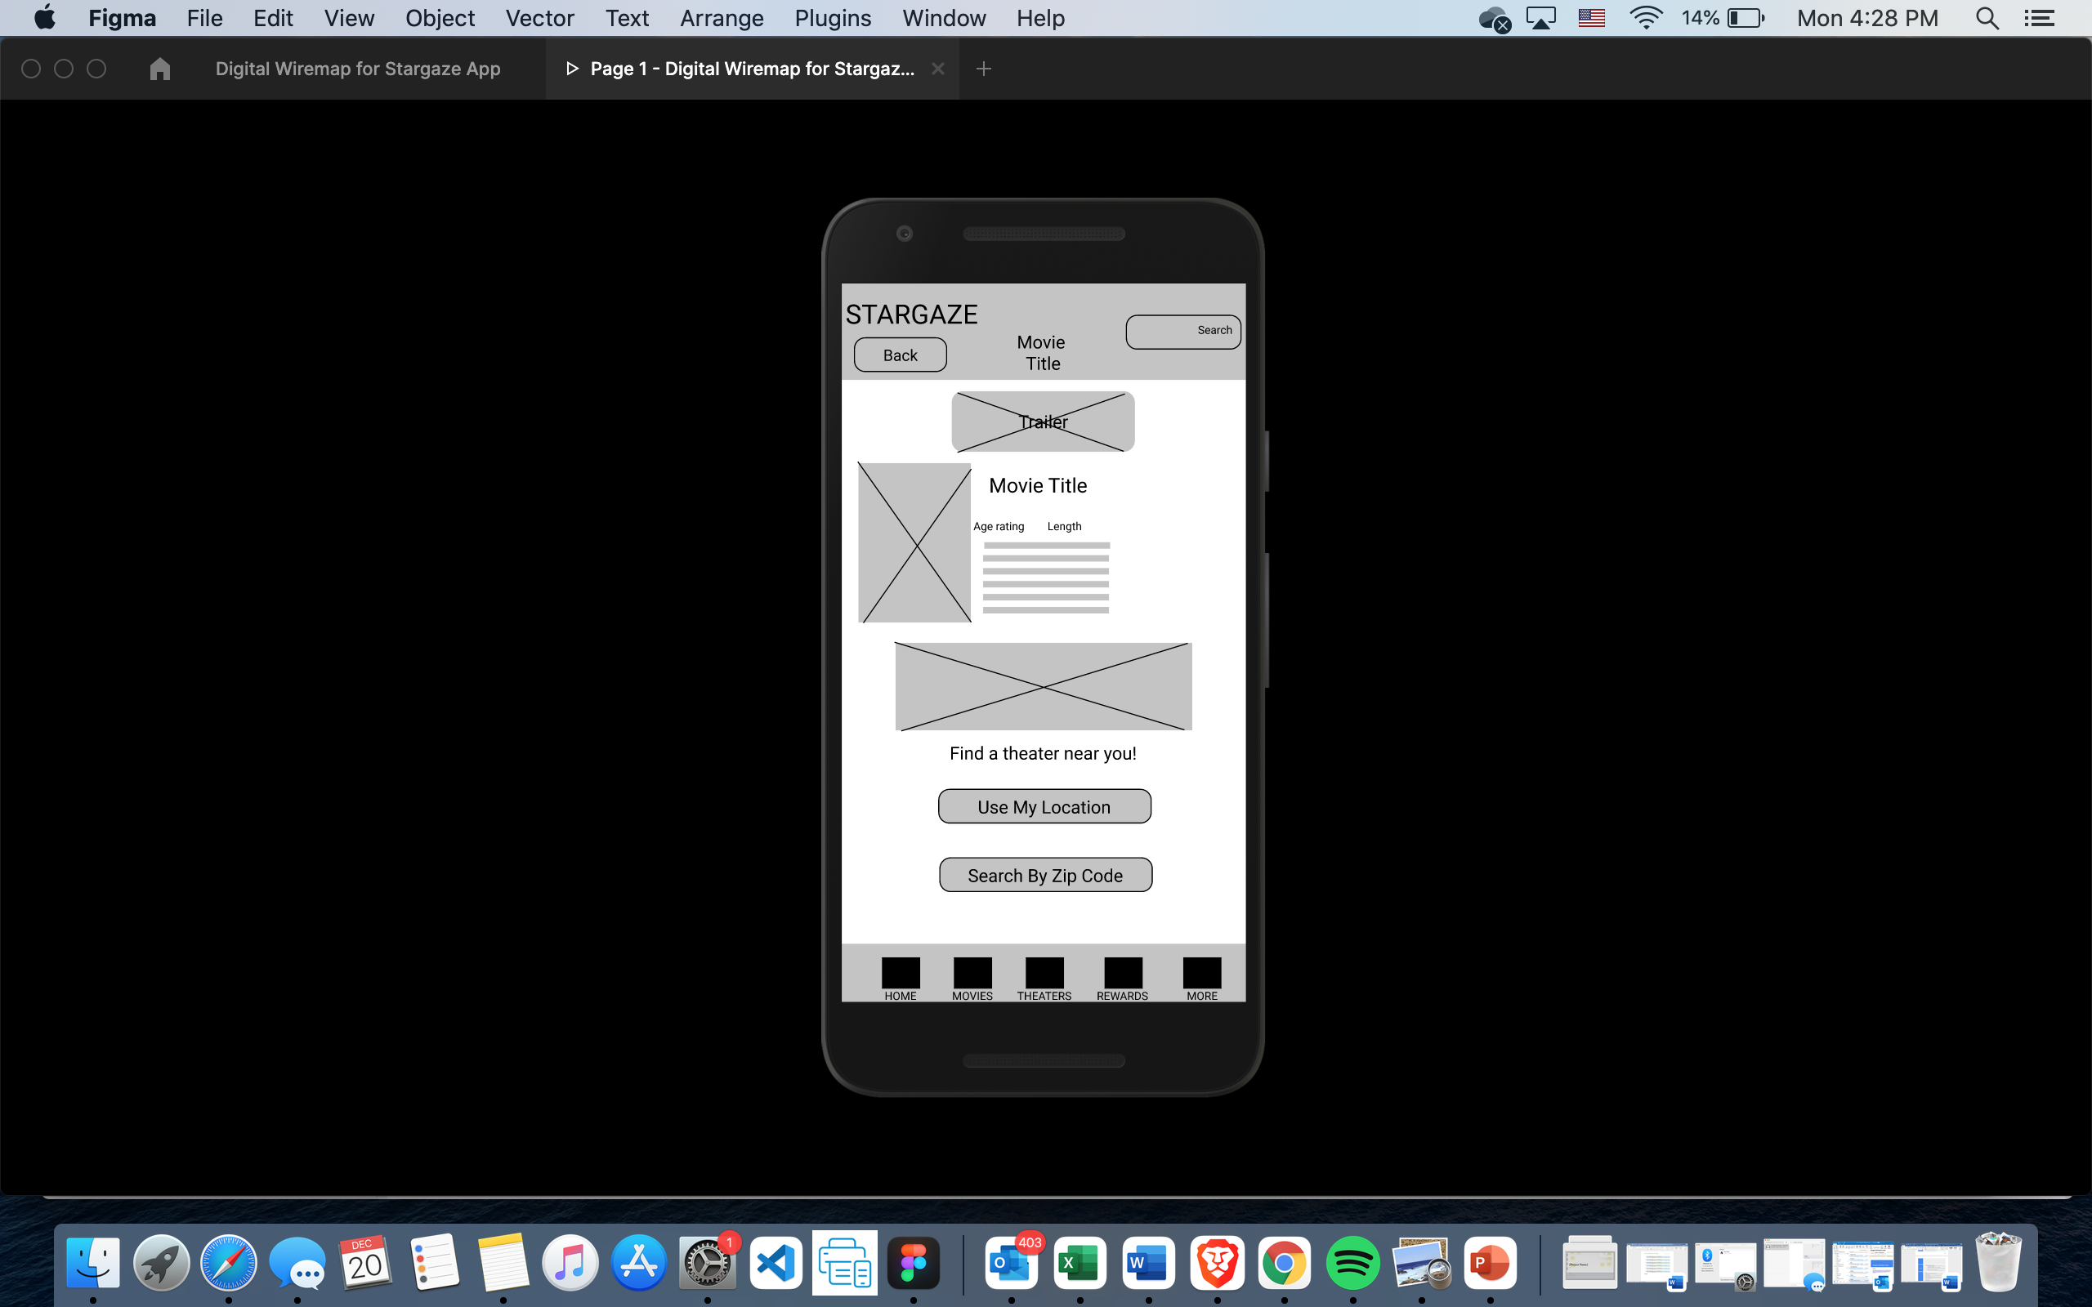
People want a simply way to select their movie theater
Supporting evidence from the usability study.
3 out of 5 participants had difficulties selecting their location for a movie theater
"I assume when you click the zip code option it will give you the closest theaters near you but I’m not sure.” J
Joe Brown, frequent movie goer in Denver, Colorado
a

Slide 9
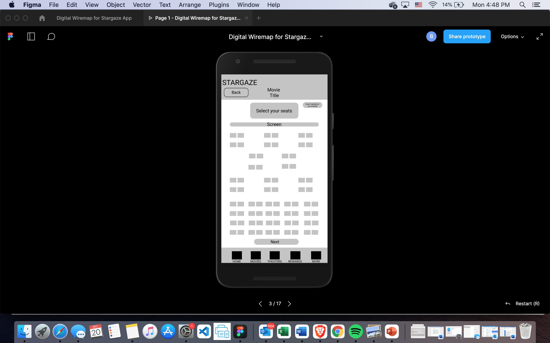
People want a simple way to select their seats
Supporting evidence from the usability study.
3 out of 5 participants thought they needed to click the select your seats icon to pick their seats.
"Some buttons on the select your seats page and the theater page may need to be looked at. I thought I needed to click those but I didn’t”
Amy Johnson, mother of family of four from Seattle, Washington
a

Slide 10
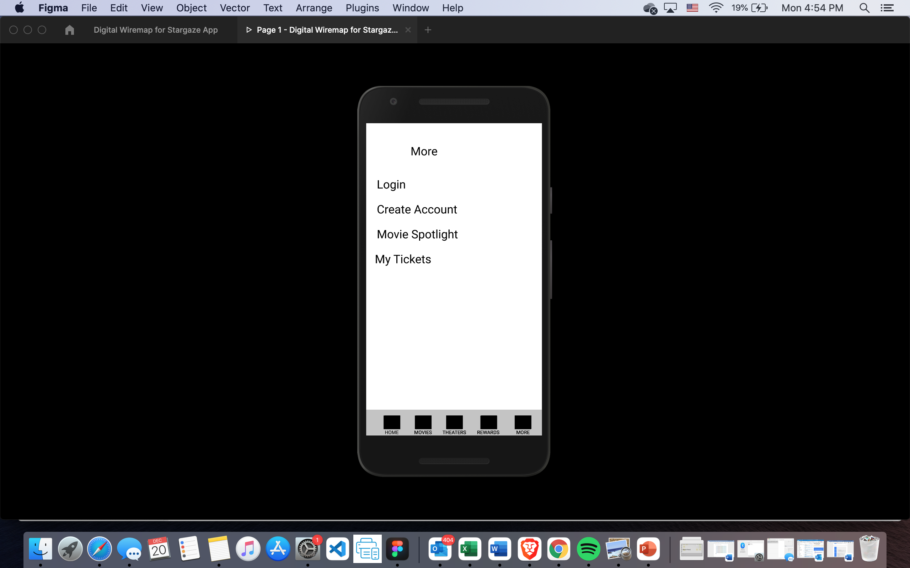
People want a place where they can see their account info
Supporting evidence from the usability study.
3 out of 5 participants wanted a page to see their account info.
“Maybe there could be a section about my account ”
Jacob Kriegsman, high school student, Detroit, Michigan
a

Slide 11
Previous Insights & Recommendations

Slide 12
Research insights
Unable to easily select location for movie theater
Unable to easily select seats
Users want a My Account Page
Point 4
Users want to be able to make sure they can select the right location for their theater
In general, users want to know how to select their seats for the movie
Users want to have a place where they can check and see their account information

Slide 13
Recommendations
Use only the Use My Current Location button on the select a theater page to show the theaters that are relevant to the user.
Redesign the text of select your tickets and add instructions so that users can easily select their tickets.
Build a My Account Page in the more section of the app and Create a account Icon in the top right corner for users to access.

Slide 14
Thank you!

